Slide 1
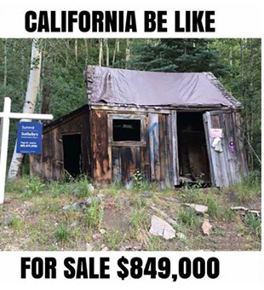
Housing Price Analysis
By Tina Brickey, Jacob Forbus, Amber Mcgarrahan, Patrick Mercado, and Brianda Salinas
Notes:
AMBER-
INTRODUCTION
Our project was to conduct a Housing Price Analysis for the state of California.
My fellow project members were Tina Brickey, Jacob Forbus, Patrick Mercado, and Brianda Salinas.
As portrayed by the meme, homes in California tend to be pretty expensive, despite their condition. If we’re talking Venice beach, and the tarp on top is included, this might not be too far off
NEXT SLIDE

Slide 2
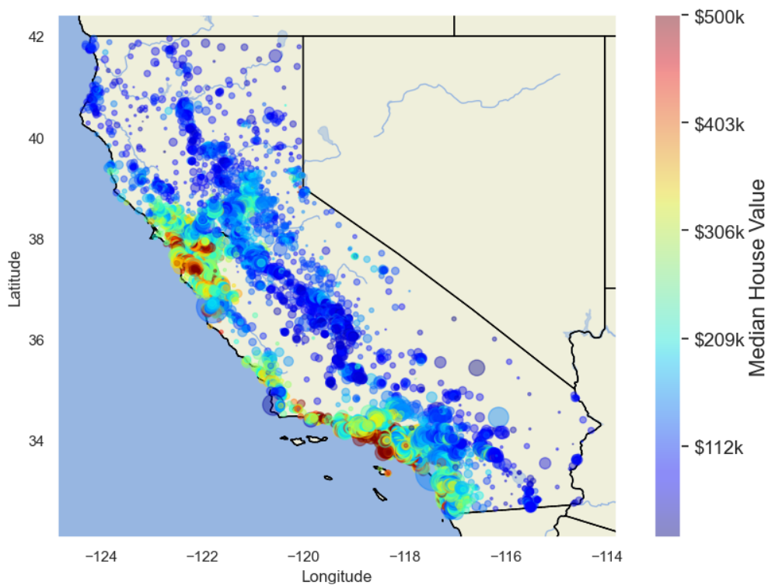
Topic: Predicting Housing Prices
The topic of our project was to create a machine learning model that can predict Housing prices based on various factors for Houses throughout the state California.
Notes:
AMBER-
The map shown on the slide displays a heatmap coded by Median house Values, higher prices being hotter and lower prices being colder.
NEXT SLIDE

Slide 3


Reasoning
As future homeowners, we want to accurately predict housing prices using a specific set of parameters, as well as determine which of those parameters affect home values the most.
Notes:
AMBER-Because while there is a web of macroeconomic factors that influence the real estate industry, such as inflation, supply & demand, and interest rates, these factors are constantly fluctuating making macroeconomic policy hard to predict. Our project does include a couple macroeconomic factors such as population and median house income, but also includes an assortment of physical house characteristics and location parameters.
NEXT SLIDE

Slide 4



Questions to Answer
What features are most influential in determining Housing Price?
How is the house price data distributed?
Does there appear to be any underlying bias in the data?
How does RandomForest’s performance compare to XGBoost’s in this instance?
Notes:
AMBER
-JUST READS QUESTIONS THEN….
NEXT SLIDE

Slide 5

Tools used in Analysis
Python
-Geopy
-Pandas
-Matplotlib
-Numpy
- Pyplot
AWS RDS
QuickDB
pgAdmin
SqlAlchemy
XGBoost
XGBRegressor
Importances
Scikit-learn:
- RandomForestRegressor
- RandomizedSearchCV
- Preprocessing
- Metrics
- train_test_split
- SimpleImputer
Tableau
Notes:
AMBER-
P:
-We used Python and its many libraries, including Geopy.
-Our data was loaded into a Pandas dataframe as well as using pandas functions such as to_sql.
-we also used Matplotlib and its numerical mathematics extension Numpy.
-and We used pyplot to create Distribution and Value Plots for each tuned model to visualize the best performances.
AWS:
-A Relational Database from AWS was established to hold the data for the project. The database instance used postgres and was connected to pgAdmin4 for management. -Data was inserted and retrieved using a SQLAlchemy and psyco.pg2 connection engine along with pandas functions.
-Quick DB was used to create our entity-relationship diagram.
XGBOOST:
-Where our decision Trees were built sequentially using the weights and gradients to improve the next tree.
-It allowed us to feed a computer algorithm an immense amount of data and have the computer analyze and make decisions based on only the input data.
-If any corrections were identified, the algorithm incorporated that information to improve its future decision making.
SCIKIT-LEARN:
-RandomForestRegressor-where the Decision Tree Fits a number of classifying decision trees and uses averaging to improve predictive accuracy and control over-fitting.
-Hyperparameter tuning using RandomSearchCV is performed on each model with each dataset.
Preprocessing
- Metrics- for our distance computations
- train_test_split- to split our arrays into train and test subsets.
-SimpleImputer was used with a median strategy to fill missing values we had instead of dropping them from our observations.
Tableau:
-an interactive dashboard was created using TABLEAU to visualize our results and draw conclusions from our data.

Slide 6
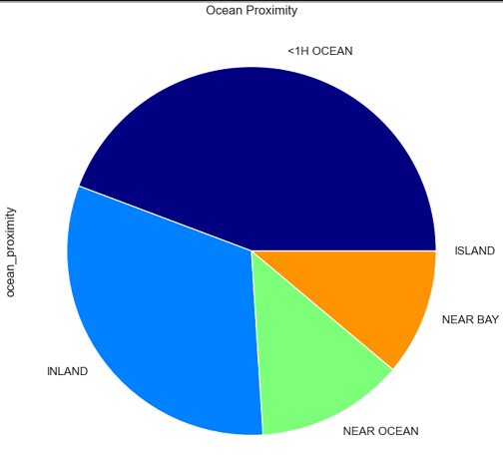
Taken from the 1990 Census concerning California home values.
The data set contains various features typically used to classify homes such as:
total rooms
total bedrooms
longitude/latitude
Certain demographic metrics:
median income
housing median age
Population
Final Dataset created by creating new features based off of initial attributes of California Data Set. Features created included:
Bedrooms per room (ratio of total rooms to bedrooms)
Rooms per house
Population per House
Miles to nearest Major City
Data Description
Notes:
bri
To begin answering our research questions, we first had to find the correct dataset. We began our research using the dataset from Boston from 1978. As we combed through this dataset we found it to be inadequate for our research. Several of the categories in the Boston dataset had underlying biased and outdated categories. Some of the categories we felt were not relevant for our research were the amount of minorities by town and the amount of blue color employees by town. It was then when we decided to go a with a different dataset. We then found the ideal dataset to answer our research questions. This dataset is from California from 1990. The categories this data contained was exactly what we were looking for. It includes the total rooms, total bedrooms, and longitude/latitude. One of the categories that stood out the most to us was ocean proximity, which is this graph right here. Our data also included demographics such as median income, housing median age, and population. With these categories we were able to analysis the data and further our research by creating our own categories. We created bedrooms per room and Rooms per house, which gives us more of an understanding of the size of the house. Population per House, which helps us know how many people are living in the house. And finally miles to nearest major city, which would help us answer our questions.

Slide 7
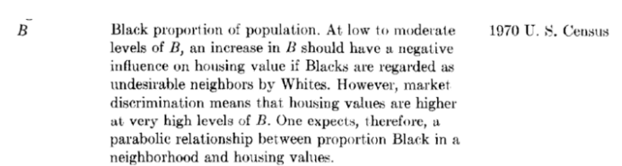
Data Exploration
The first dataset: Ames Boston Housing Dataset from the 1970 US Census.
Included factors such as:
CRIM- Crime rate
LSTAT - people of lower status %
PT ratio - pupil-student ratio
B - ratio of blacks in proportion to the town
Source: https://archive.ph/fBsOX
Notes:
PATRICK
“The first dataset that we explored was from a famous data set for Boston Housing data from the 70s. In the dataset there were normal parameters to consider, such as average number rooms and age of owners. However, upon closer inspection of the dataset, there are more questionable parameters such as the crime rate, black proportion of the town, pupil-to-student ratio, and Lower status proportion. In the bottom right is an actual quote from the census paper. With an issue like this present in the dataset, we knew we definitely could not go along with it. Therefore, we ended up switching to the more recent 1990 California dataset.”
NEXT SLIDE

Slide 8
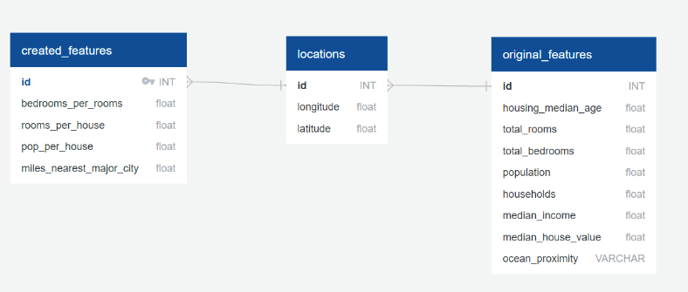
Data Exploration
An AWS Relational Database is created named housing-database.
The RDS instance named housing-database is created with PostgreSQL and connected to pgAdmin4. The data is held in the postgres database within the housing-database AWS RDS instance.
Notes:
PATRICK
“In terms of data exploration we created an AWS relational database named “housing-database” using the California Housing set. We used PostgreSQL through pgAdmin4. The data is then held in the postgres database in the housing-database AWS RDS instance.”
NEXT SLIDE

Slide 9


Price Predictions
Random Forest
XGBoost
Intuitive
Resistant to Overfitting and Outliers
Easy to use
Training Time
Instability
RandomForest with Extreme Gradient Boosting Applied
Fast
Struggles with sparse, unstructured data.
Potential for Overfitting
Sensitive to Outliers
Each Model is trained and tuned using 2 separate data sets. One set including only Original Features, another with the Created and Original Features Combined.
Notes:
Decision Trees are one of the most commonly used types of ML Model. They can be used for both classification and regression. They are simple to use and understand. They do not require data normalization or scaling in most cases.
Ensemble learning algorithms combine multiple machine learning algorithms to obtain a better model. Both random forest and GBDT build a model consisting of multiple decision trees. The difference is in how the trees are built and combined.
Random forest uses a technique called bagging to build full decision trees in parallel from random bootstrap samples of the data set. The final prediction is an average of all of the decision tree predictions.
Random Forest has potential for overcomplexity and long training times. Also, it can’t extrapolate well and can become unstable with small changes in the data. These flaws can lead to increased errors especially with new information unseen in training data. Has trouble handling covariate shift.
GBDTs iteratively train an ensemble of shallow decision trees, with each iteration using the error residuals of the previous model to fit the next model.The final prediction is a weighted sum of all of the tree predictions.
Gradient Boosting is an extension of boosting where the process of additively generating weak models is formalized as a gradient descent algorithm over an objective function. Gradient boosting sets targeted outcomes for the next model in an effort to minimize errors. Targeted outcomes for each case are based on the gradient of the error (hence the name gradient boosting) with respect to the prediction.
XGBoost Speeds up training time through parallel processing. Applying the gradient function to each tree during tree creation.
Random forest “bagging” minimizes the variance and overfitting, while GBDT “boosting” minimizes the bias and underfitting.

Slide 10
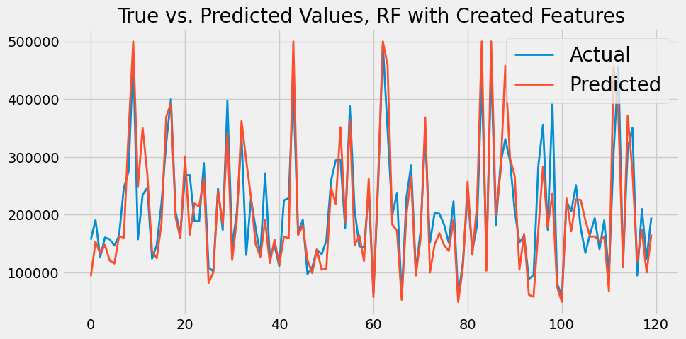
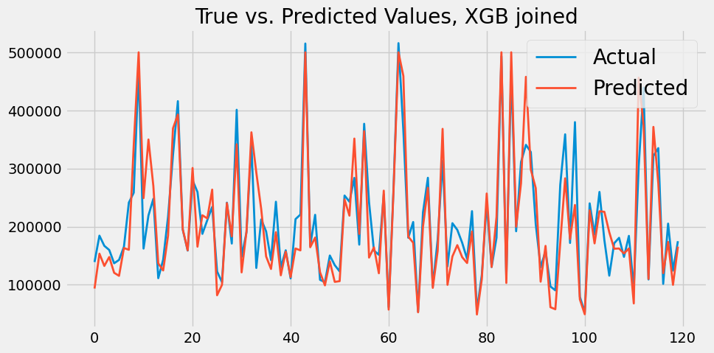
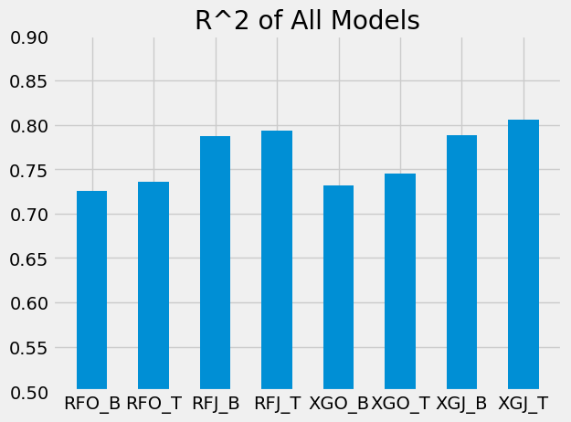
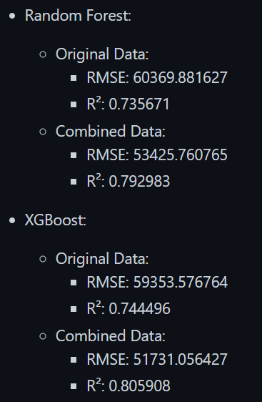
Prediction Results
Training and Testing:
Each dataset is prepared for the models in three steps using Sklearn: Encoding, Scaling, and Splitting.
A Base Model is trained, parameter tuning is conducted, predictions are made using the best model found, and metrics are collected for each dataset.
Notes:
Sklearn OneHotEncoder
Sklearn StandardScaler
Sklearn train_test_split. 20% of the data is held as a testing set. The final prepared training sets contain 16,512 observations. The dependent variable is passed to the splitting function in its raw format
Hyperparameter tuning using RandomSearchCV K-fold cross-validation 3 subsets of the data for 100 and 200 samples from the parameters grid.
RMSE(Root Mean Square Error): It is a measure of the squared difference between the prediction from our model and the actual value. Shown in the same scale as the dependent variable. This is the average error in US Dollars.
R²: It is the measure of variance found in the dependent variable that can be explained by the independent variables, with perfect predictions returning a value of 1.0. (goodness of fit)

Slide 11
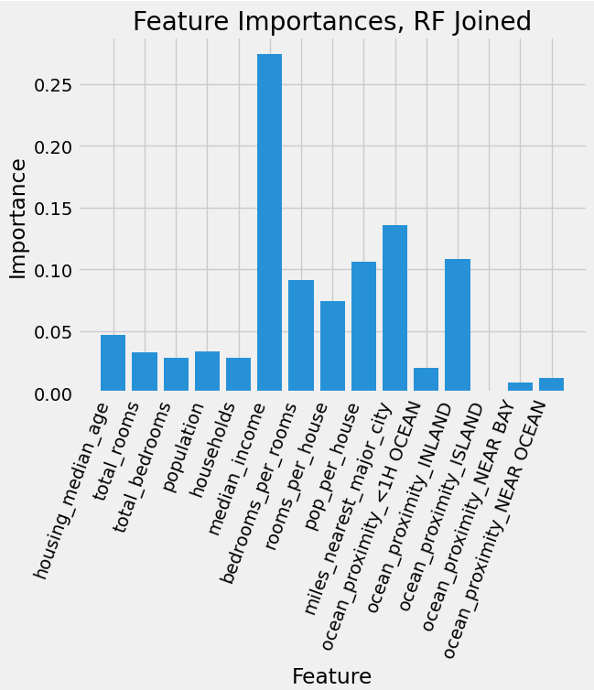
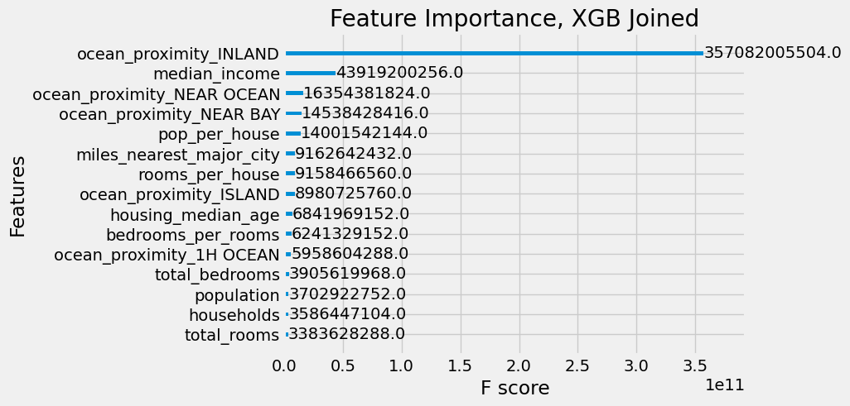
Model Insights
Notes:
Random Forest feature importances are provided by the fitted attribute feature_importances_ and they are computed as the mean and standard deviation of accumulation of the impurity decrease within each tree.
XGBoost feature importances are provided by the fitted attribute plot_importances, ‘Gain’ is the improvement in accuracy brought by a feature to the branches it is on
Random Forest importances aligns with correlation values seen during the preliminary analysis.
Here our created feature stand out as aids to the model.
XG notes only the ocean proximity categorical variables Inland value. This is a dense area of low home values found away from the coast. The blue area on the map
Both Models highlight a notable feature, just the inverse. The ocean proximity variable. The proximity of a house to certain desirable locations is noted as a highly important feature when estimating the value of a house.

Slide 12
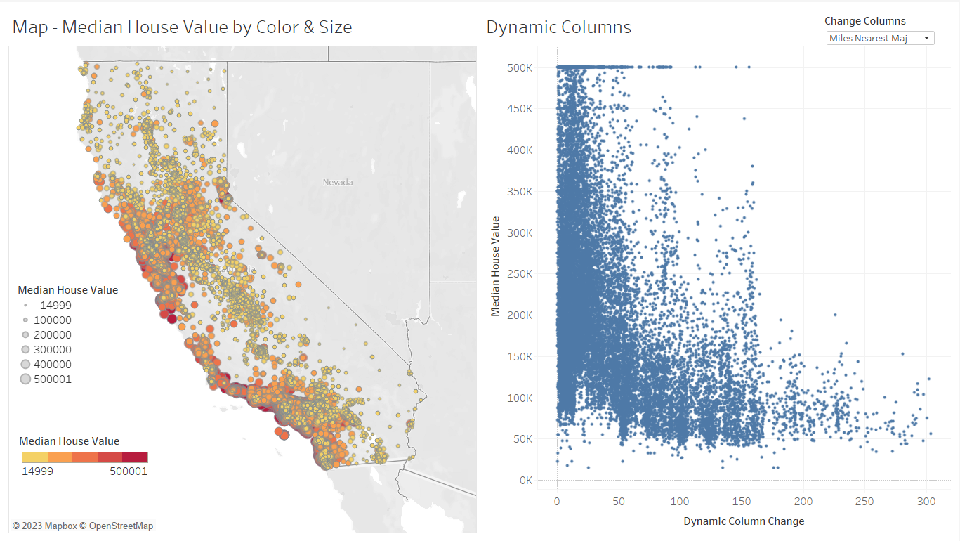
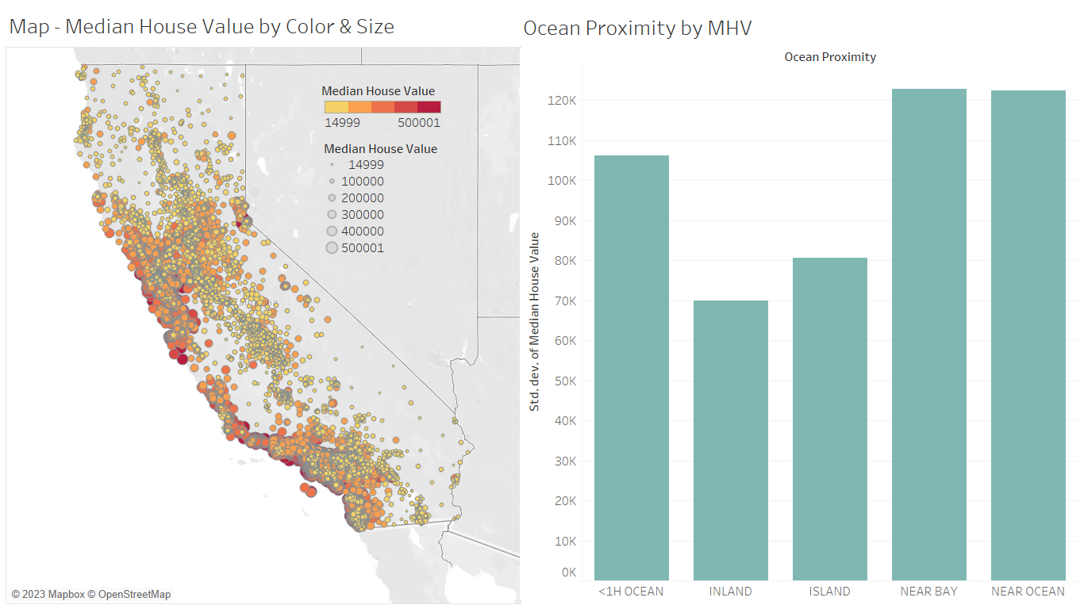
Tableau Dashboard
Notes:
Tina
Pull up tableau and walk thru dashboard

Slide 13
Questions
Answers
What features are most influential in determining Housing Price?
How is the house price data distributed?
Does there appear to be any underlying bias in the data?
How does RandomForest’s performance compare to XGBoost’s in this instance?
Ocean or city proximity
Evenly distributed
No underlying bias
XGBoost’s performance was more accurate than RandomForests
Notes:
TINA
Evenly distributed except for the capping of the house prices
Wanted to open up for any questions

